Slide 1
Information Loss Metrics as Utility Measures for k-Anonymous Datasets
Romain de Spoelberch
Yves-Alexandre de Montjoye
Florimond Houssiau

Slide 2
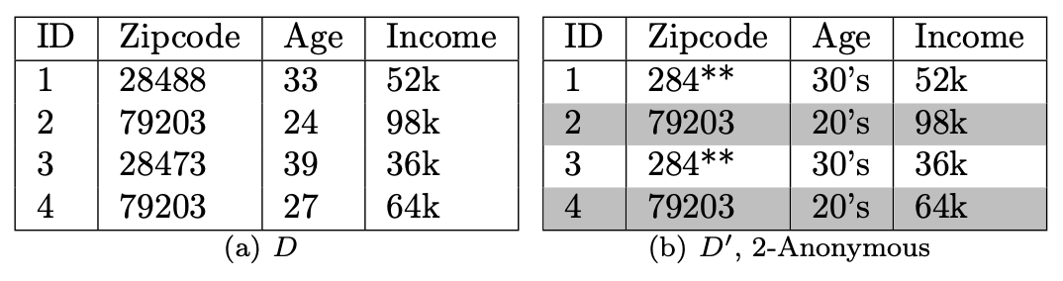
Motivation
Great survey data you want to release but…
You can’t because it’s not anonymous… There’s linking issues
You know Tim took part in the survey; you know Tim’s address and age
So, we k-Anonymize (more on that later)
You’ve now lost some details of the data
How much of it?

Slide 3
Motivation
How much information is lost?
Information Loss Metric
used to quantify information loss in a dataset
Supposed to help people understand quality of the anonymous data
Entropy Metric: 0.78
Classification Metric: 0.22
Distinguishability: 0.56
Ambiguity: 0.91
….
Entropy Metric: 0.78
Or 12 of them…
However, link between utility and information loss metrics is unclear
And, hence, whether they’re as useful as believed
Although an intuitive one, it remains an assumption

Slide 4

Motivation
Hence, our question:
Are information loss metrics good measures of utility in $k$-anonymous datasets?

Slide 5
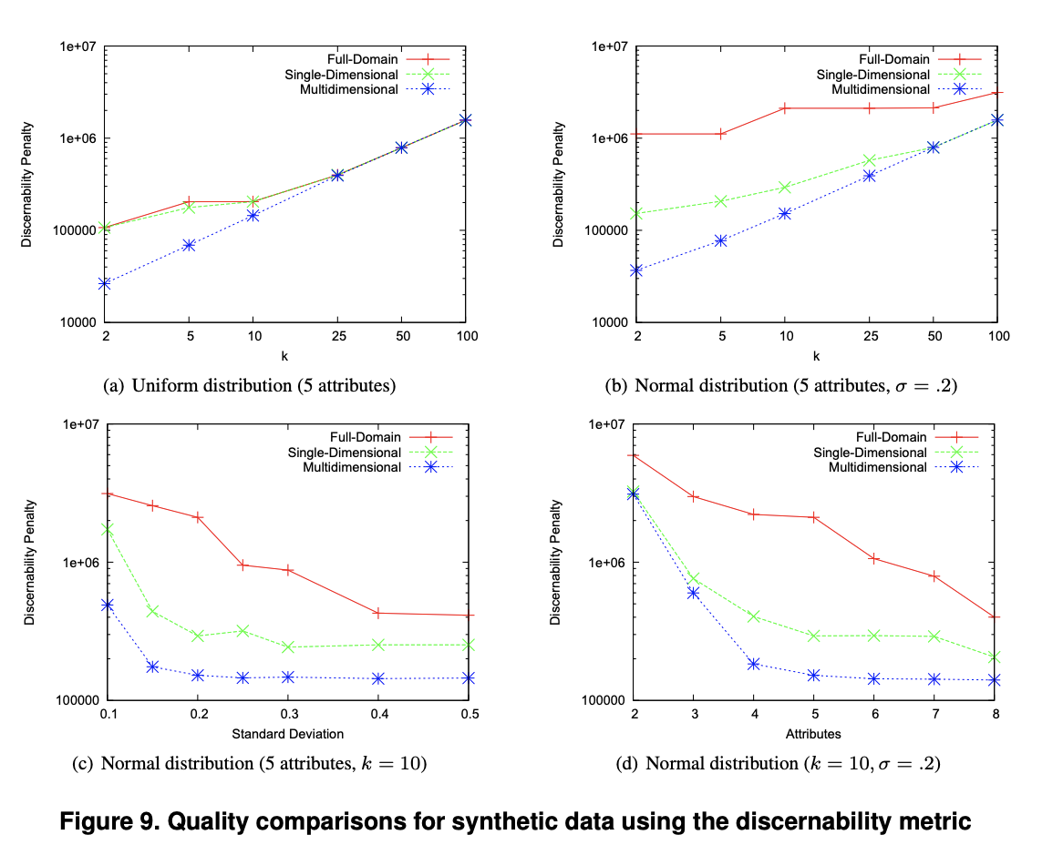

Motivation
Metrics see pervasive use
Used as benchmarks when presenting algorithms
Ex: Mondrian paper

Slide 6
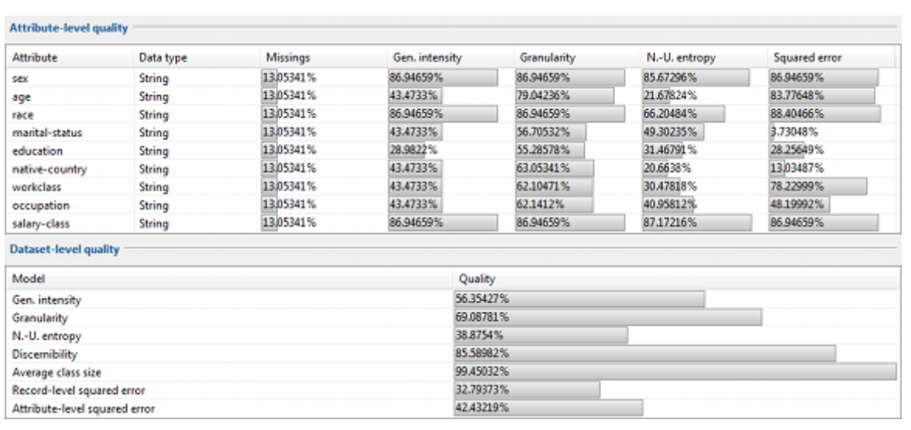

Motivation
Used in anonymization software

Slide 7
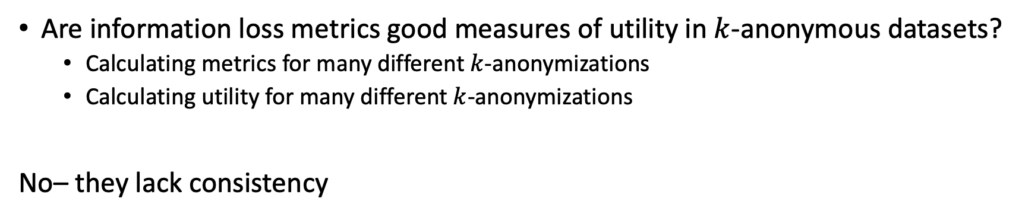
Summary
Are information loss metrics good measures of utility in $k$-anonymous datasets?
Calculating metrics for many different $k$-anonymizations
Calculating utility for many different $k$-anonymizations
No– they lack consistency

Slide 8
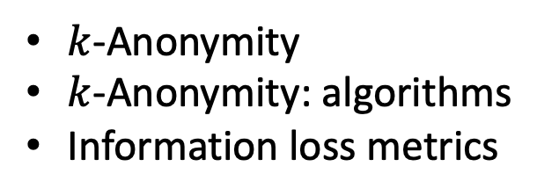
Background
$k$-Anonymity
$k$-Anonymity: algorithms
Information loss metrics

Slide 9



$k$-Anonymity
Three types of attributes: direct identifiers, quasi-identifiers, sensitive attributes
A dataset is $k$-Anonymous if and only if no individual is distinguishable from at least $k−1$ others based on quasi-identifiers
Call these groups equivalence classes

Slide 10
$k$-Anonymity
Often done by
Suppression: removing rows
Generalization: removing details to fit values in broader categories
Generalization and Suppression imply loss of information

Slide 11
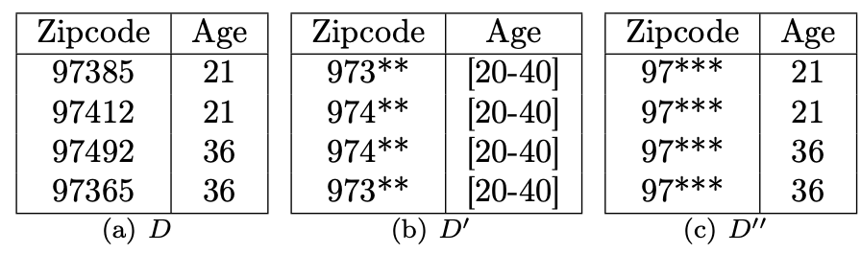
$k$-Anonymity
Many ways to k-anonymize
Example for quasi identifiers age and zipcode
Different amounts of lost information

Slide 12
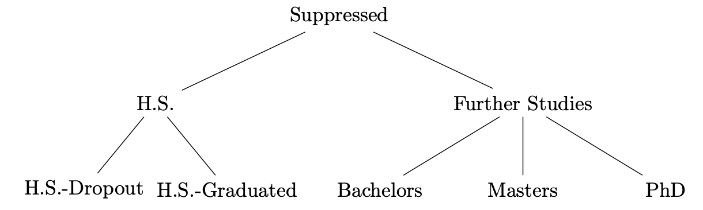
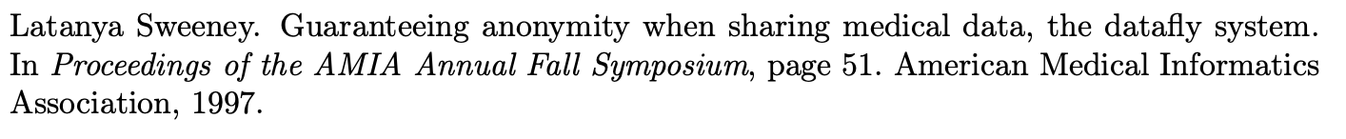
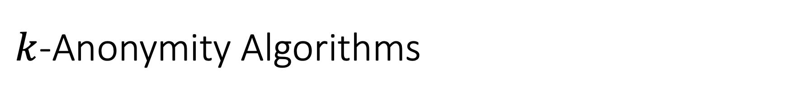
$k$-Anonymity Algorithms
Datafly
Single-dimensional generalization
Takes generalization tree per attribute
Generalize column with largest domain until k-anonymous set

Slide 13

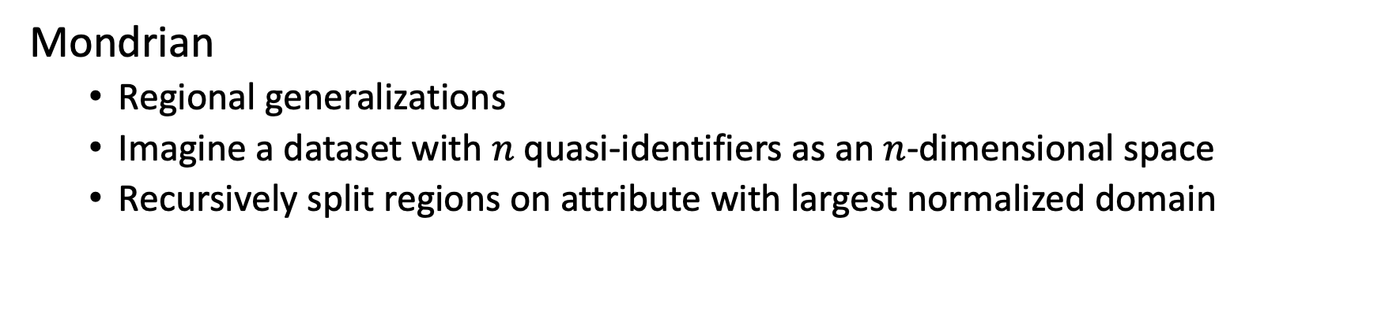
$k$-Anonymity Algorithms
Mondrian
Regional generalizations
Imagine a dataset with $n$ quasi-identifiers as an $n$-dimensional space
Recursively split regions on attribute with largest normalized domain

Slide 14
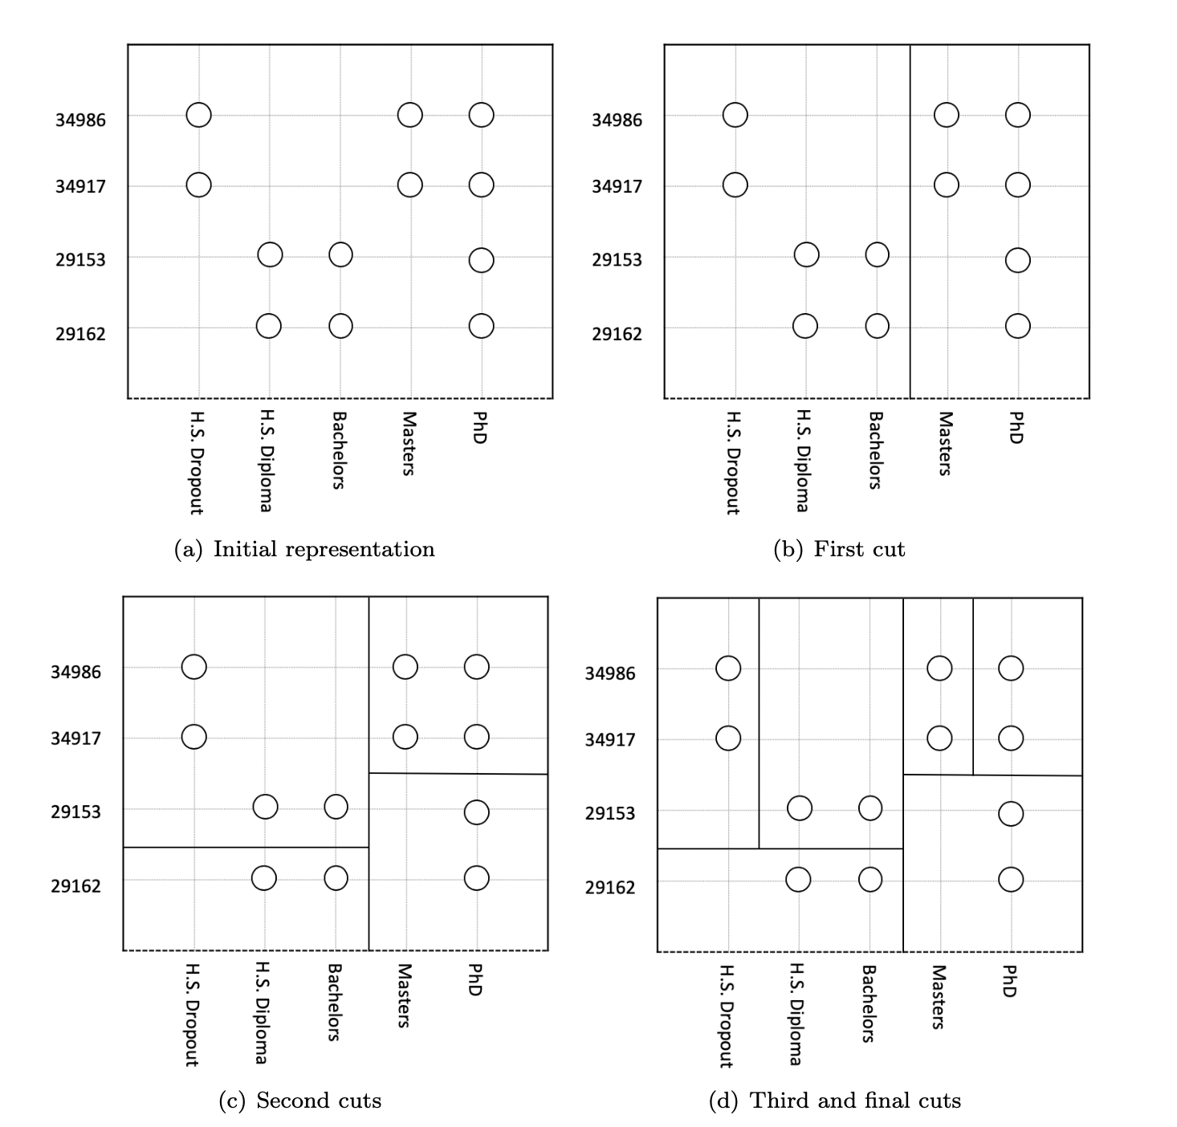
Mondrian Example
Two quasi-identifiers: zipcode and education level
How would you deal with unordered attributes?

Slide 15
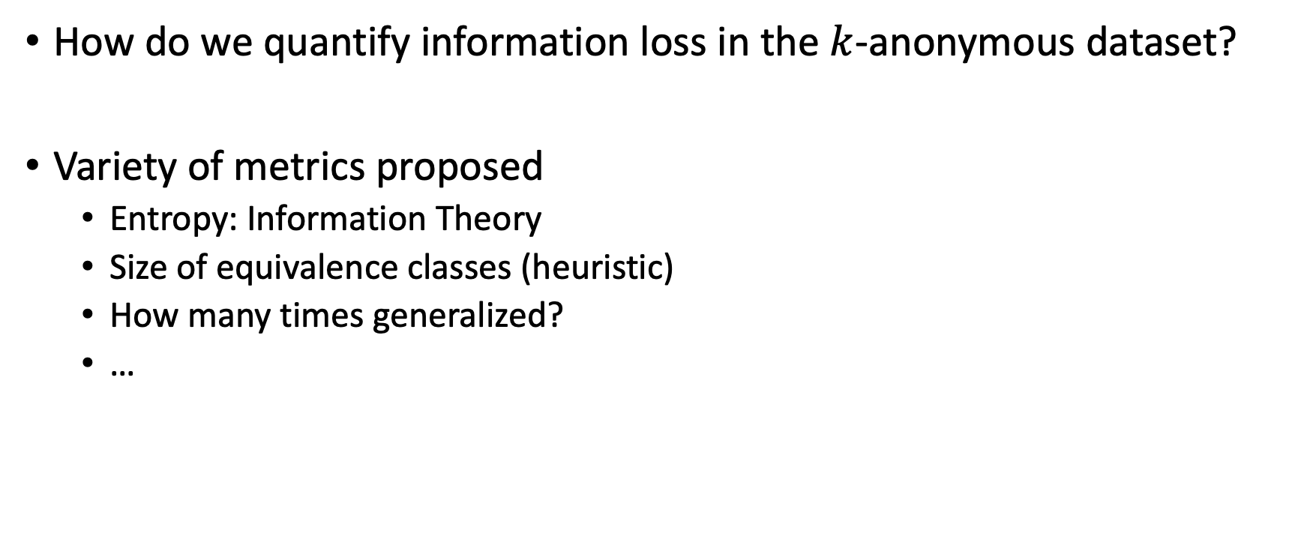
Information Loss Metrics
How do we quantify information loss in the $k$-anonymous dataset?
Variety of metrics proposed
Entropy: Information Theory
Size of equivalence classes (heuristic)
How many times generalized?
…

Slide 16
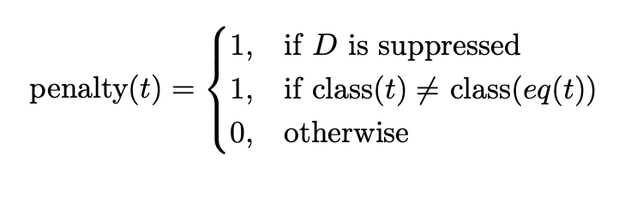
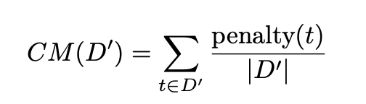

Classification Metric
Specific use for classification tasks
A measure of “purity” in equivalence classes
A good anonymization, will group similar records together
Similar records will have similar classes
Hence, good anonymization is equated to “pure” equivalence classes

Slide 17
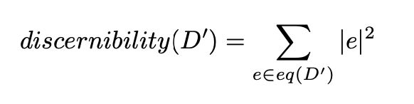

Discernibility Metric
Measuring how grouped the records are, using equivalence class sizes

Slide 18
Project

Slide 19
PROJECT OVERVIEW
Measure Utilities
Analysing dataset utility against metrics and meta-metrics
Datasets
Batch K-Anonymizations using different hyper-parameters
Measure Metrics

Slide 20
PROJECT OVERVIEW
Measure Utilities
Analysing dataset utility against metrics and meta-metrics
Datasets
Batch K-Anonymizations using different hyper-parameters
Measure Metrics

Slide 21
Datasets
We pick four different datasets
Different sizes
Different types/numbers of attributes
Different origins (synthetic, real data)
Amongst others, we have the notorious ADULT dataset
We label the others BIRTH, RING, and HEART

Slide 22
PROJECT OVERVIEW
Measure Utilities
Analysing dataset utility against metrics and meta-metrics
Datasets
Batch K-Anonymizations using different hyper-parameters
Measure Metrics

Slide 23
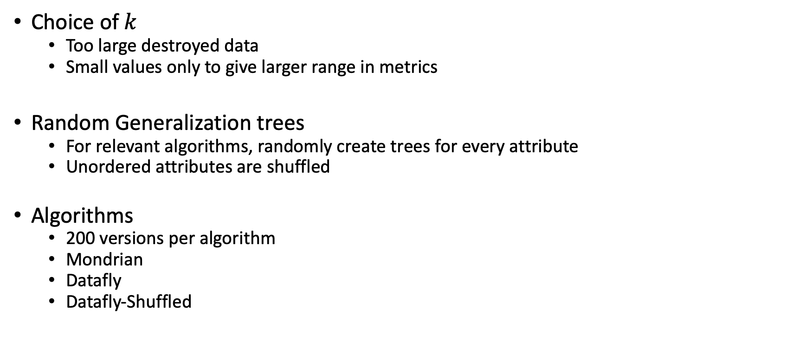

$k$-Anonymizations
Choice of $k$
Too large destroyed data
Small values only to give larger range in metrics
Random Generalization trees
For relevant algorithms, randomly create trees for every attribute
Unordered attributes are shuffled
Algorithms
200 versions per algorithm
Mondrian
Datafly
Datafly-Shuffled

Slide 24
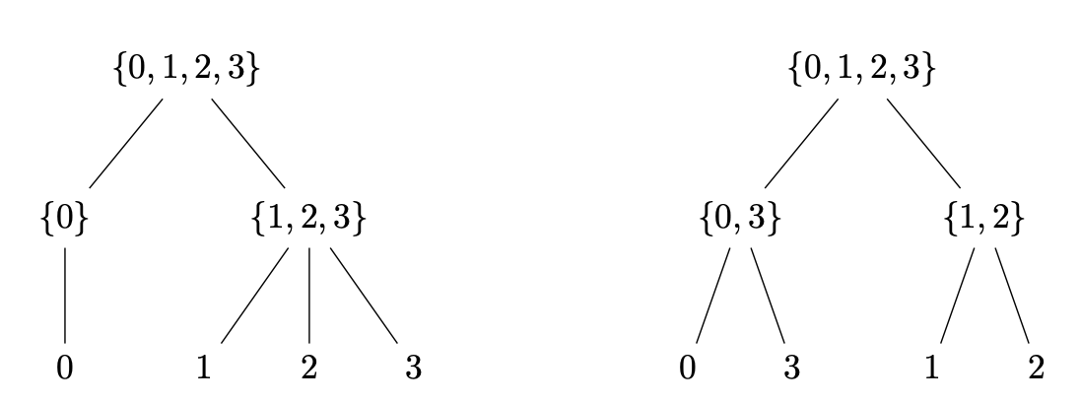

$k$-Anonymizations
Ordered generalization tree
Unordered generalization tree
(Datafly)
(Datafly-Shuffled)
Datafly-Shuffled loss of coherence
Can metrics pick up on this?

Slide 25
PROJECT OVERVIEW
Measure Utilities
Analysing dataset utility against metrics and meta-metrics
Datasets
Batch K-Anonymizations using different hyper-parameters
Measure Metrics

Slide 26
Measuring Utility
Different classification tasks
Logistic Regression
Random Forest
k-Nearest Neighbor
Dataset’s utility
how well a classifier performs when using a k-anonymous dataset as a training set
Tested on real data (not anonymous)
Minimal pre-processing

Slide 27
PROJECT OVERVIEW
Measure Utilities
Analysing dataset utility against metrics and meta-metrics
Datasets
Batch K-Anonymizations using different hyper-parameters
Measure Metrics

Slide 28
PROJECT OVERVIEW
Measure Utilities
Analysing dataset utility against metrics and meta-metrics
Datasets
Batch K-Anonymizations using different hyper-parameters
Measure Metrics

Slide 29
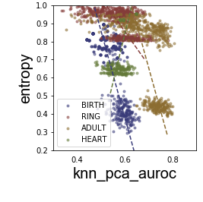
Analysis
Scatterplot of the utility measure (AUROC score on the k-NN classifier) against metric (entropy)
Metrics would be useful if they can be used as general measures for utility
Major Takeaways:
Disjoint clusters
Lack of consistency across algorithms
Lack of consistency across datasets
Lack of consistency across classifiers
Lack of linear correlations

Slide 30
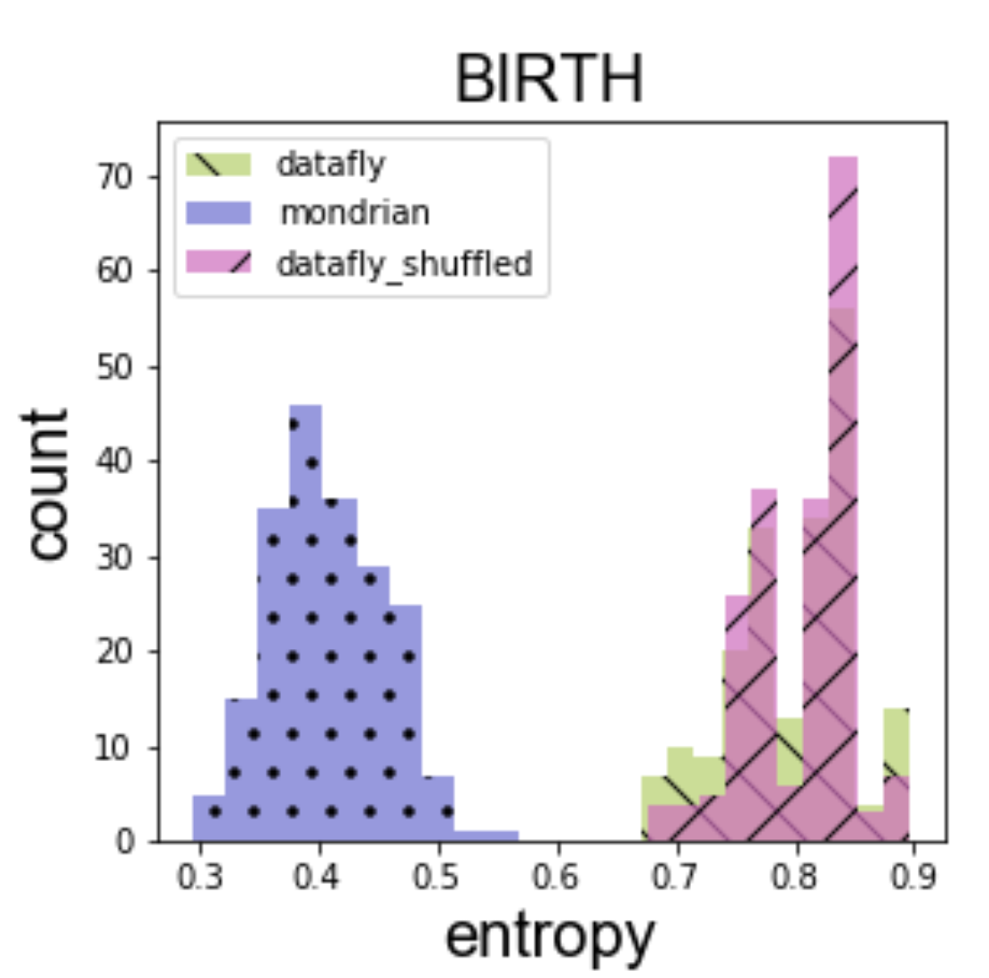
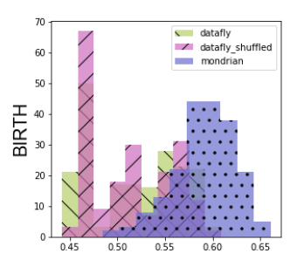
Analysis- Disjoint Clusters
Mondrian results for metrics very different to Dataflies
Major overlap between the two dataflys on both metrics and utilities
Data degradation too large for Datafly
Attribute choice: binary attributes are left over
For all further analysis, we condition our data on algorithm used
Measured Utilities
knn_pca_auroc

Slide 31
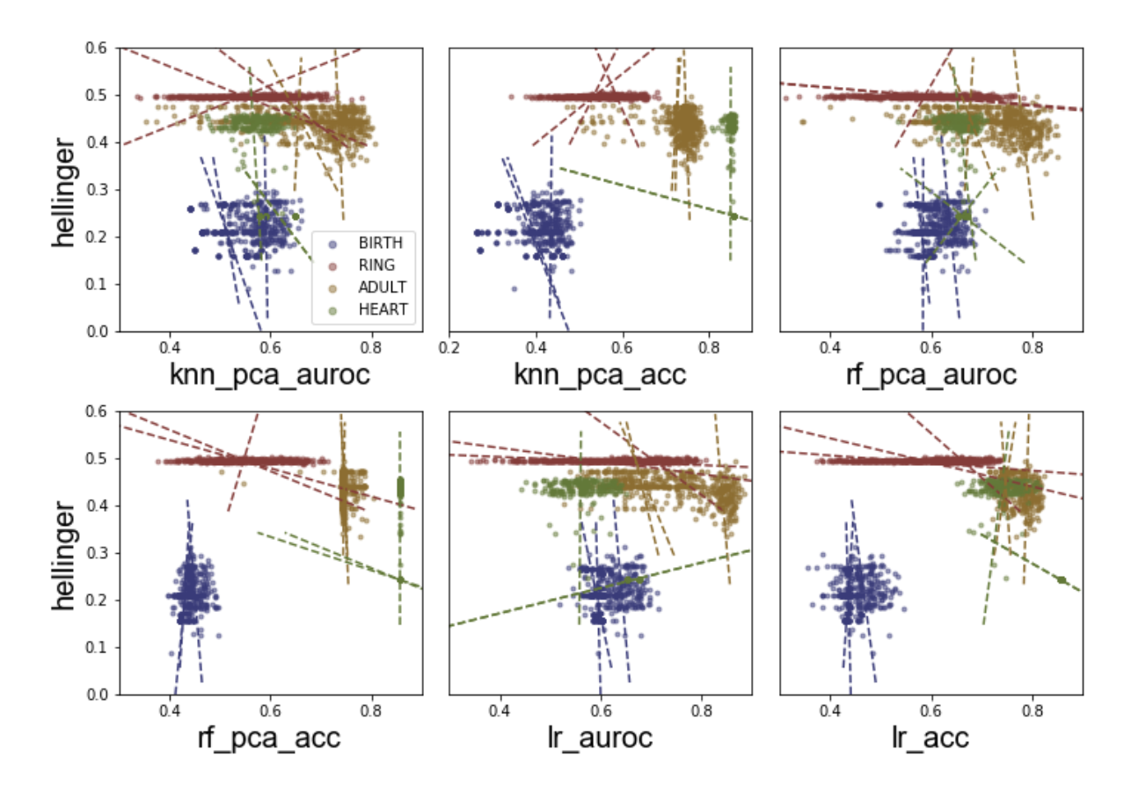
Separation by Algorithm Used

Slide 32
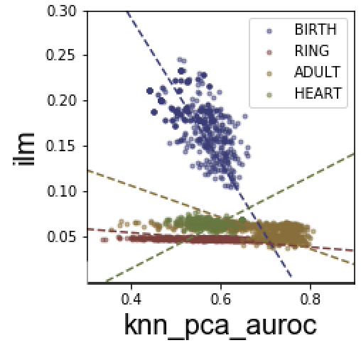
Analysis- Consistency for Datasets
ilm metric on k-Nearest Neighbour (AUROC)
Very different trends across the datasets
Reduce usability of the metric in question because you need to know the trend on the dataset…

Slide 33
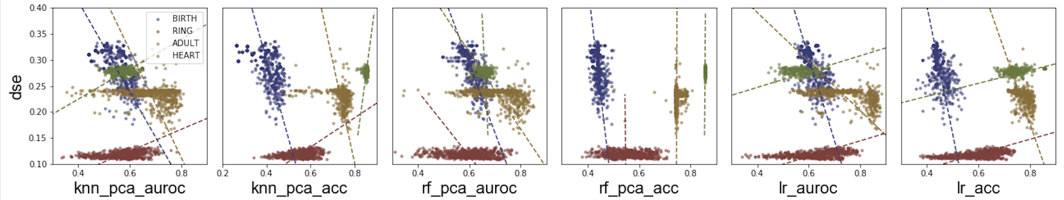
Analysis- Consistency for Classifiers
Similar analysis as for datasets
Example: Squared Distance Error metric, across classifiers
No consistency; metrics are classifier dependent

Slide 34
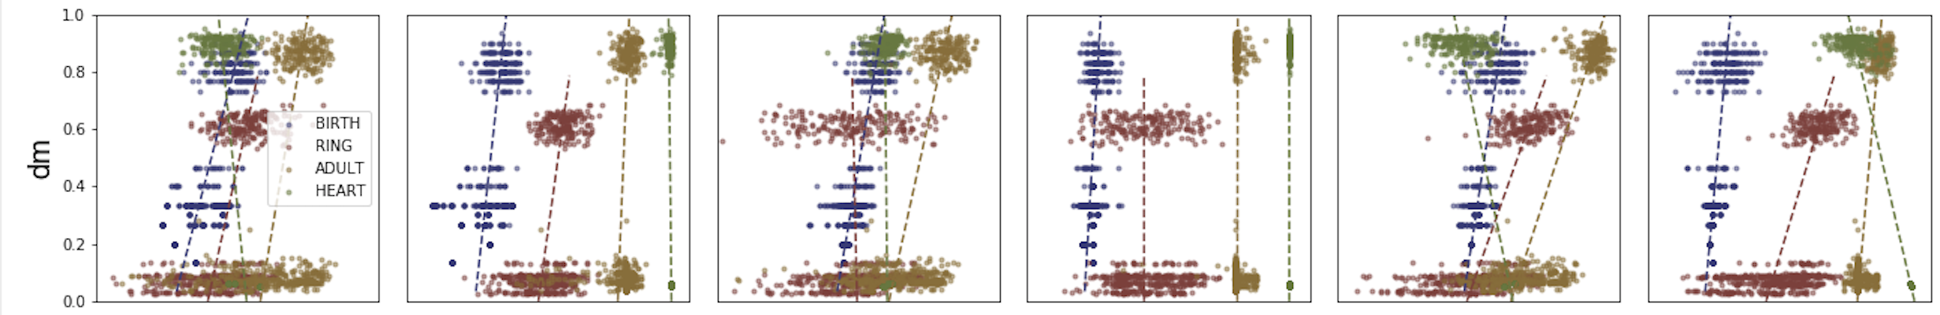

Analysis- No Correlations
Even semi-consistent metrics… don’t have correlation
Example: Vertical lines for diameter metric
Metrics not influenced by utility…

Slide 35
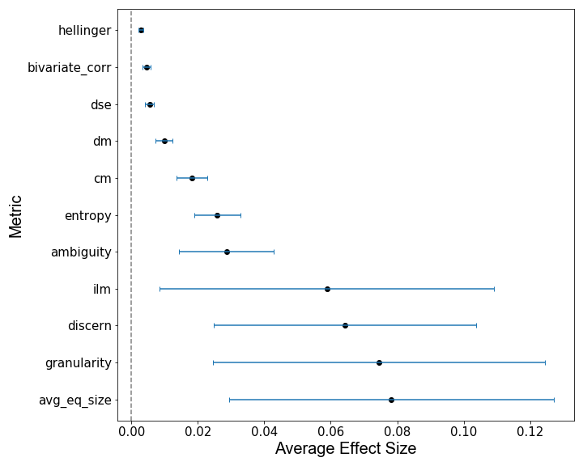
Analysis- Average Effect Sizes
Taking the average effect size of the metrics when used as predictors for utility measures
Very large confidence intervals
Discernibility and average equivalence class size both perform well and rely on the size of equivalence classes

Slide 36
Analysis
What have we seen so far?
Very little consistency
For the metrics that did have some, no correlation
No convincing results from the average effect sizes
Propose a more intuitive method to assess utility
Given two anonymous datasets, can an analyst use a single metric to pick out the dataset that has the most utility?
Very common situation (eg. Arx platform)

Slide 37
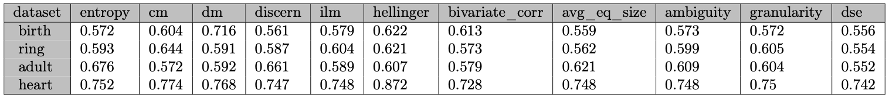
1v1- Individual Metrics
Per combination of algorithm, dataset, and utility measure
Take 1000 pairs of datasets
Out of the two datasets, how often we can correctly pick the one with most utility by a single metric?
Compared to the baseline of a random choice, these aren’t very good

Slide 38
PROJECT OVERVIEW
Measure Utilities
Analysing dataset utility against metrics and meta-metrics
Datasets
Batch K-Anonymizations using different hyper-parameters
Measure Metrics

Slide 39
Meta-Metrics
As we see them, metrics not very predictive
What if we don’t know how to use the metrics and they actually do contain information on utility?
Next step: Can we show that metrics, used at their most powerful, still aren’t useful?

Slide 40
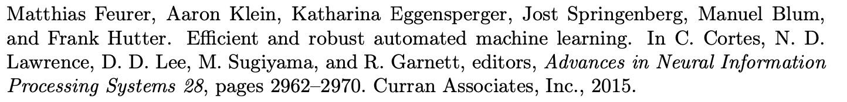
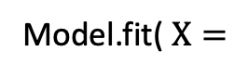
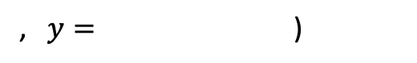
Meta-Metrics
We use Auto-Sklearn, to
Train an ensemble model per combination of dataset, algo, utility measure
Train for 24 hours
Model’s utility prediction is “Meta-Metric”
entropy | cm | dm | …. | granularity | dse
0.7714513422075117 | 0.5641547861507128 | 0.3333333333333333 |  | 0.19047619047619047 | 0.3146457116676352
0.831280828129976 | 0.5695858791581806 | 0.3333333333333333 |  | 0.20209000096983806 | 0.3162689134805965
0.3781485508888008 | 0.4344874405974202 | 0.8666666666666667 |  | 0.0883199172404875 | 0.2687358079399361
0.7322403335426162 | 0.560081466395112 | 0.4 |  | 0.1963275466330456 | 0.28558730471117433
knn_auroc
0.4435348607851622
0.4992333928096932
0.5763610935116641
0.4960146026965905
Model.fit( $X=$
, $y=$ )

Slide 41
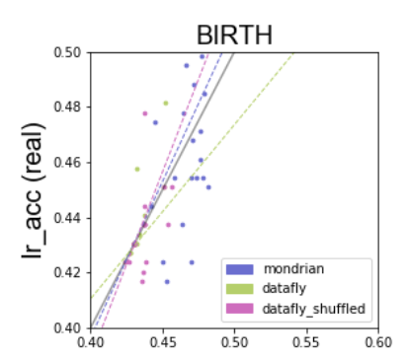
Meta-Metrics Scatter
Predicted Utility

Slide 42
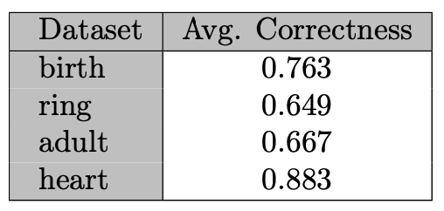
Meta-Metrics 1v1
Same argument as for individual metrics
Pairs of datasets
Using the Meta-Metric, can we identify the most useful dataset
At their most powerful, only marginally better than individual metrics

Slide 43
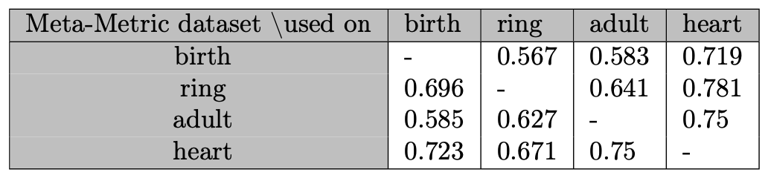
Meta-Metrics “Transferability”
We also show that the models trained for a specific dataset are not transferable
1v1 analysis
Use the Meta-Metric for one dataset to try and predict the most useful of two versions of another kind of dataset
Same experiments changing algorithms and utility measures; same results

Slide 44
Conclusion

Slide 45
The Good / The Bad
+: Covered a lot of bases on parameters of a k-anonymization
-: Pick k-anonymiztion algorithms that perform better to see distinction between Datafly and Datafly-Shuffled
Should allow to notice problems with Entropy
-: Larger range for k
Still small ranges for some metrics

Slide 46
Conclusion
Predicted Utility
Individuals metrics can’t predict utility
Meta-Metrics can’t predict utility
Scatterplots
Average Effect Sizes
1v1 tests
1v1
“Transferability” argument

Slide 47
Conclusion
Metrics are not good predictors for utility
Individual Metrics: 1v1 comparisons only 15% better than random
Meta-Metrics: additional 10% better
This is the first research into the actual predictive power of metrics
Provides cause to reassess how metrics are used

